Slide 1
Adherence from Electronic Healthcare Data
Samuel Allemann & Alexandra Dima
ESPACOMP 2019 Preconference Workshop 2: Adherence data analysis

Slide 2
Program
09:00-10:15 | Introduction to EHD data analysis | Sam Allemann, Alex Dima
 | Review of data characteristics and types of EHD datasets; appropriate methods to use EHD data for initiation, implementation and persistence; summaries vs trajectories.
10:15-10:45 | EHD data preparation | Sam Allemann
 | Review of steps necessary for preparing EHD data for analysis – data preparation checklist and range of choices available; using multiple datasets (prescription, dispensing, hospitalisations)
10:45-11:00 | BREAK
11:00-12:00 | Demo R analysis EHD data | Sam Allemann
 | Presentation AdhereR functions of an R script for analyzing an example EHD dataset.
12:00-12:45 | Run analysis on the EHD dataset provided | Small group work
 | Participants will re-run the analysis demonstrated on their own computers and interpret & experiment with the script provided.

Slide 3
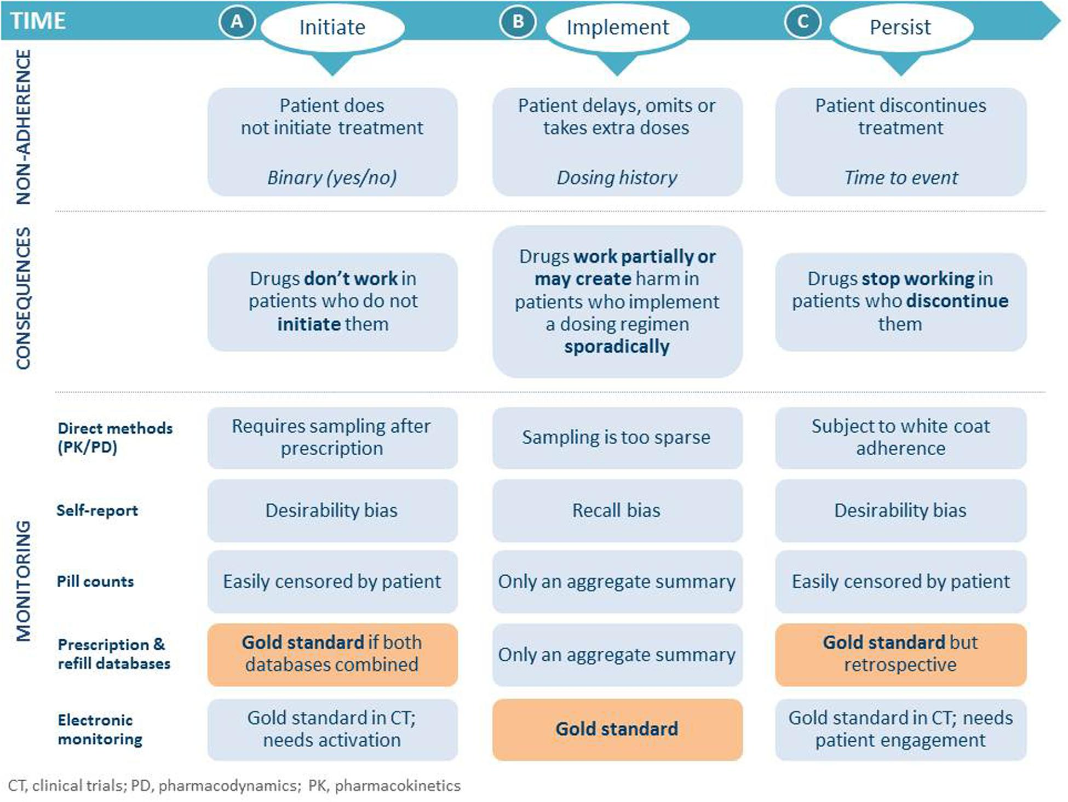
Adherence Measurement
Vrijens, B., S. Antoniou, M. Burnier, A. de la Sierra and M. Volpe (2017). Frontiers in Pharmacology 8: 100.

Slide 4
Use of EHD
Estimate prevalence of (non-)adherence
Identify predictors of (non-)adherence
Model impact of adherence on clinical outcomes
Identify individuals with suboptimal adherence for targeted interventions

Slide 5

Opportunities
Unobtrusive
Data from large samples at low cost
Real-world use

Slide 6

Limitations
low granularity
variable data entry quality & standards
limited info recorded

Slide 7
Adherence estimations: Assumptions
Accurate medication records
First fill = first intake
Fixed daily dosage
Medication administered as indicated
No refill = medication not administered
Medications not purchased or borrowed elsewhere
Medications not diverted
No unknown treatment interruptions or dosing changes
Arnet, I., M. J. Kooij, M. Messerli, K. E. Hersberger, E. R. Heerdink and M. Bouvy (2016). Annals of Pharmacotherapy 50(5): 360-368.

Slide 8
Data sources
Source | Pros | Cons
Prescription | Prescriber timeline Dosage | Patient timeline? Availability? Interruptions? (Quantity?) Multiple providers?
Pharmacy refills | Patient timeline Quantity Availability (Dosage) | Prescriber timeline? Interruptions? Multiple providers?
Insurance claims (reimbursement) | Prescriber & patient timelines Quantity Availability (Interuptions) | Dosage? Multiple payers?

Slide 9
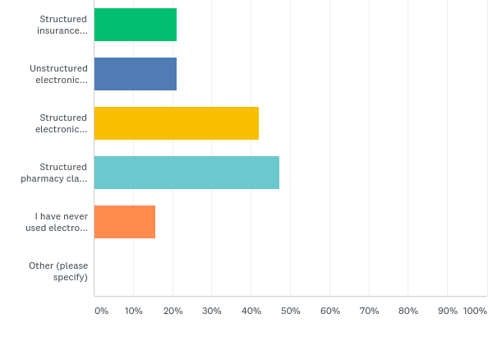
Electronic Healthcare Data

Slide 10
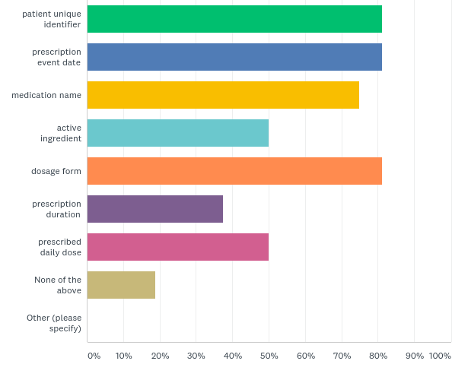
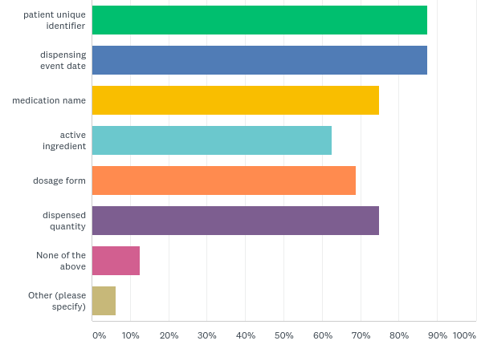
Available information

Slide 11
Adherence estimations: Requirements
PATIENT_ID | MEDI_ID | DATE | QUANTITY | PERDAY
37 | medA | 04/10/2036 | 30 | 4
37 | medA | 07/30/2036 | 30 | 4
37 | medA | 09/15/2036 | 30 | 4
37 | medB | 01/02/2037 | 50 | 4
37 | medB | 01/31/2037 | 50 | 4
76 | medA | 12/13/2035 | 30 | 1
76 | medA | 01/18/2036 | 30 | 1
76 | medA | 01/23/2036 | 60 | 2
76 | medA | 04/25/2036 | 60 | 2
76 | medA | 08/08/2036 | 60 | 2
DURATION

Slide 12
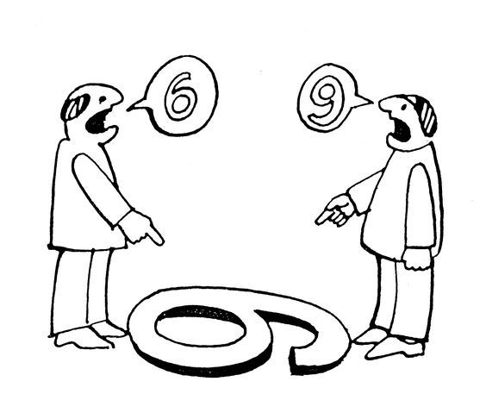
EHD-based adherence measures
Continuous Multiple Interval Measure of Oversupply
Continuous Measure of Medication Acquisition
63.5%
Medication Possession Ratio
Medication Refill Adherence
Proportion of Days Covered
63.0%
Continuous Measure of Medication Gaps
Dates Between Fills Adherence Rate
Compliance Rate
84.4%
109.7%
Refill Compliance Rate
Continuous, Single Interval Measure of Medication Aquisition
104.8%
Hess, L. M., M. A. Raebel, D. A. Conner and D. C. Malone (2006). Annals of Pharmacotherapy 40(7-8): 1280-1288.

Slide 13
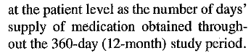
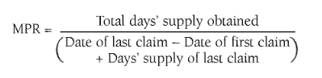
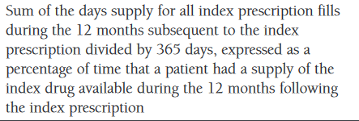
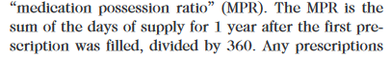
Medication Possession Ratio
«Medication Possession Ratio»
Hess, L. M., M. A. Raebel, D. A. Conner and D. C. Malone (2006). Annals of Pharmacotherapy 40(7-8): 1280-1288.

Slide 14
Adherence calculations: the basics
First prescription
End of prescription
Implementation
First Fill
1st Refill
2nd Refill
3rd Refill
Gap
t_{s}
t₀
t₁
t₂
t₃
t₄
t₅
t_{e}
Initiation
Persistence
Discontinuation
Follow-up window

Slide 15
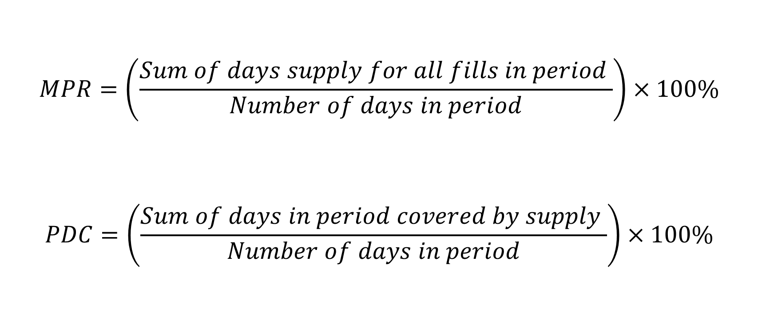
MPR vs. PDC
$$MPR=\left(\frac{Sum of days supply for all fills in period }{Number of days in period}\right)×100\%$$
$$PDC=\left(\frac{Sum of days in period covered by supply }{Number of days in period}\right)×100\%$$

Slide 16
MPR vs. PDC
150
150
MPR =
= 100%
30
150
30
30
30
150
30
PDC =
= 100%
150

Slide 17
MPR vs. PDC
150
120
MPR =
= 100%
30
150
30
30
120
30
PDC =
= 100%
150

Slide 18
MPR vs. PDC
150
120
MPR =
= 100%
30
150
30
30
120
30
PDC =
= 100%
150

Slide 19
MPR vs. PDC
120
120
MPR =
= 120%
30
120
30
30
90
30
PDC =
= 75%
120

Slide 20
MPR vs. PDC
120
30
90
MPR =
= 75%
30
120
30
30
105
30
PDC =
= 87.5%
120

Slide 21
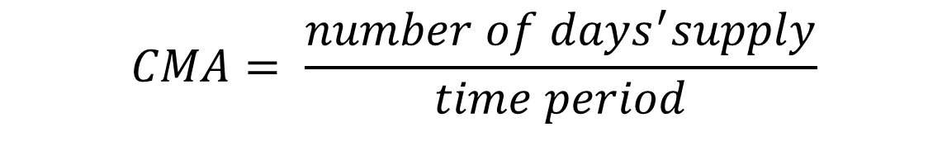
Estimation of Implementation
Implementation
First Fill
Refill
Refill
Refill
CMA: Continuous multiple-interval Measure of medication Availability
$$CMA= \frac{number of days^{′}supply}{time period}$$

Slide 22
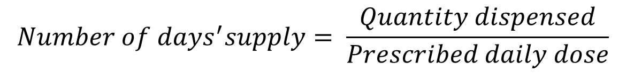
Number of days’ supply
$$Number of days^{′}supply= \frac{Quantity dispensed}{Prescribed daily dose}$$
Prescription
Lisinopril 5 mg 1-0-0
Lisinopril 5 mg 2-0-0
Lisinopril 10 mg 1-0-0
Pharmacy Claims
30 Tbl
100 Tbl
100 Tbl
30 Tbl
Arnet, I., M. J. Kooij, M. Messerli, K. E. Hersberger, E. R. Heerdink and M. Bouvy (2016). Annals of Pharmacotherapy 50(5): 360-368.

Slide 23
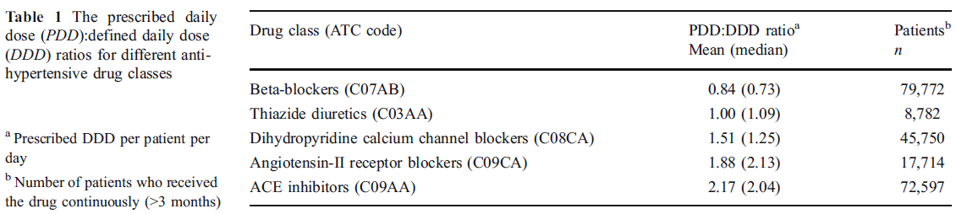
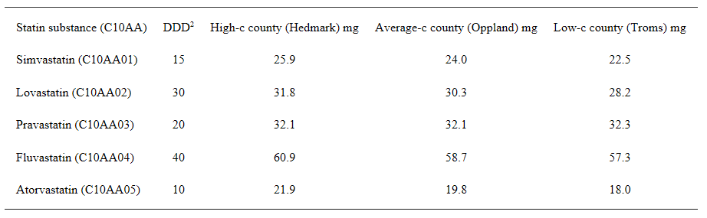
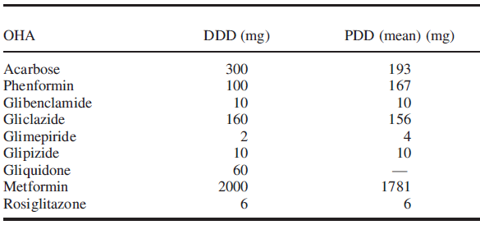
Defined Daily Dose?
Defined Daily Dose (DDD): The assumed average maintenance dose per day for a drug used for its main indication in adults.
Grimmsmann, Thomas, and Wolfgang Himmel (2011). European journal of clinical pharmacology 67(8): 847-854.
Hartz, Ingeborg, et al. (2007) BMC clinical pharmacology 7(1): 14.
Duarte‐Ramos, F., & Cabrita, J. (2006). Pharmacoepidemiology and drug safety 15(4): 269-274.

Slide 24

Persistence: Mind the gap!
Episode 1
Episode 2
Refill
Refill
Refill
Refill
Refill
Refill
Discontinuation
Re-Initiation

Slide 25
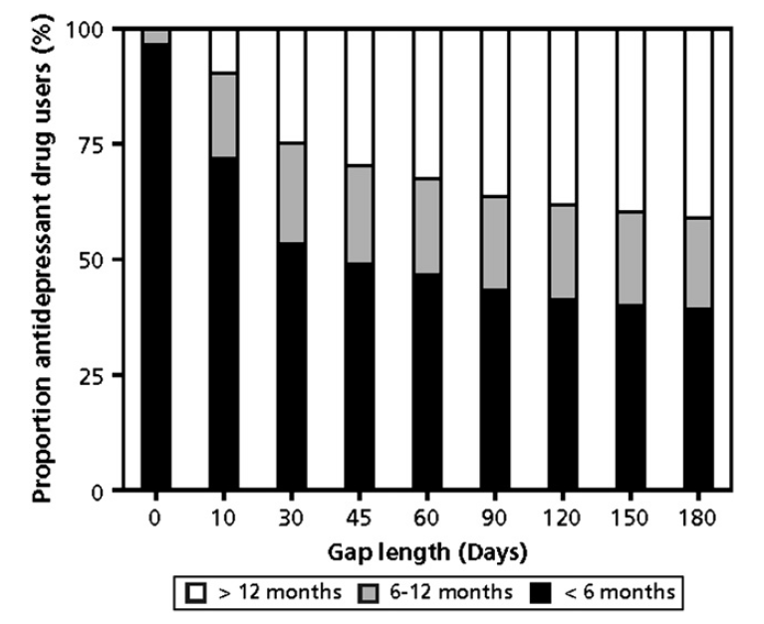
Gap length: influence on drug treatment episode
Greevy, R., M. Huizinga, C. Roumie, C. Grijalva, H. Murff, X. Liu and M. Griffin (2011). Clinical Pharmacology & Therapeutics 90(6): 813-819.
Gardarsdottir, H., Souverein, P. C., Egberts, T. C., & Heerdink, E. R. (2010). Journal of clinical epidemiology 63(4): 422-427.

Slide 26
Summary vs. Trajectories
Poor Implementation
CMA = 75%
Drug Holiday
CMA = 75%
NON-Persistence
CMA = 75%
Time

Slide 27
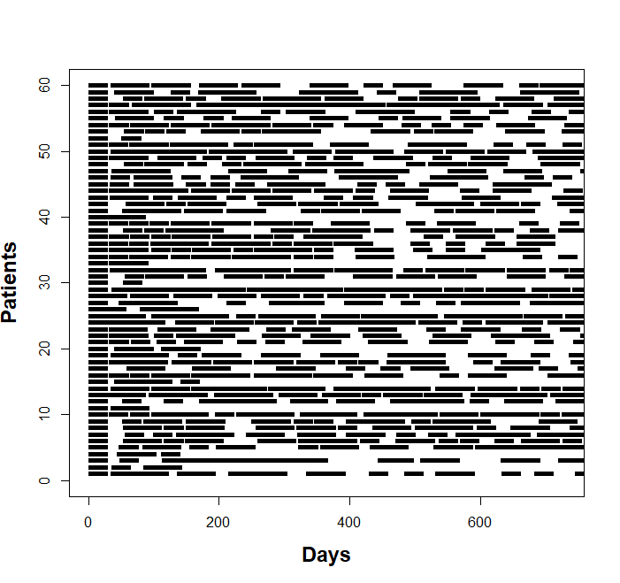
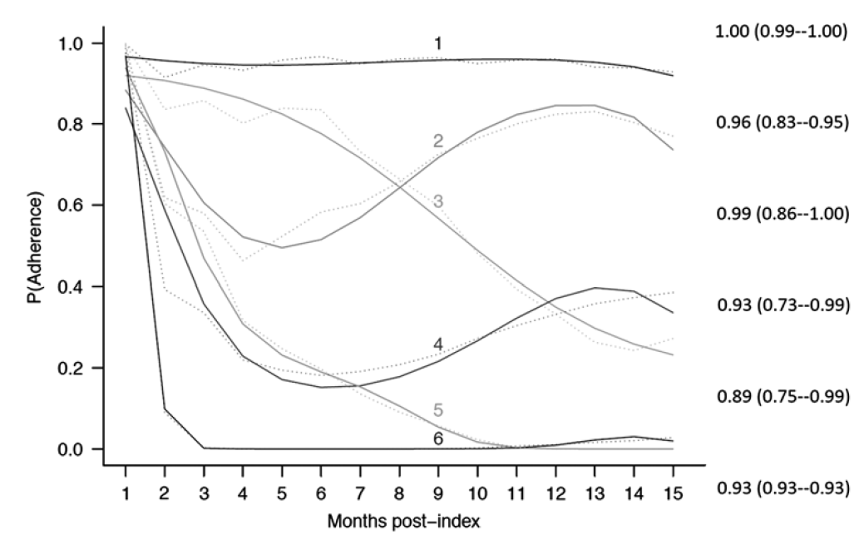
Adherence Trajectories
?
Franklin, Shrank, Pakes, et al. Medical Care 51, no. 9 (September 2013): 789–96.

Slide 28
Adherence estimates for sliding windows
Time
Which adherence estimation within windows?
Which window size?
Which overlap between windows?

Slide 29
Adherence estimates for sliding windows
Time
LCMA1: perfect adherence until the supply is exhausted
100% | 70% | 65% | 65% | 85% | 50% | 65% | 100%
1 | 0 | 0 | 0 | 1 | 0 | 0 | 1
LCMA2: administration is evenly distributed over the time between refills
75% | 75% | 70% | 65% | 65% | 70% | 70% | 100%
0 | 0 | 0 | 0 | 0 | 0 | 0 | 1
>80%
>80%

Slide 30
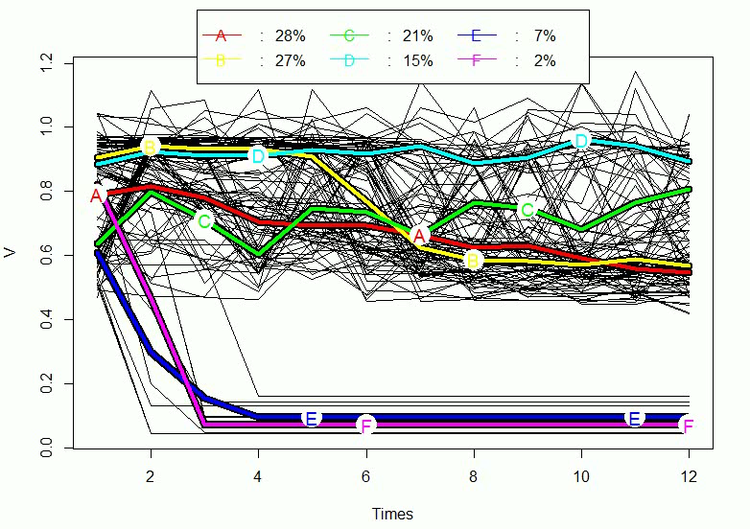
Sliding windows: trajectories

Slide 31
Impact of window size and overlap on classification accuracy
Allemann et al. Frontiers in pharmacology 10 (2019): 383.

Slide 32

Open-source analysis and visualization of medication adherence from electronic healthcare data
DISPENSING EVENTS
EVENT DURATIONS
CMA
ID
Event date
Duration
(Medication class)
(Daily dose)
Simple CMA
CMA per episode
CMA sliding window
PRESCRIBING EVENTS
SPECIAL PERIODS
TREATMENT EPISODES
(INTERACTIVE) PLOTTING
< v0.3
PRESCRIPTION EPISODES
TIME TO INITIATION
v0.5
Dima, A, S Allemann, und D Dediu. „AdhereR: An Open Science Approach to Estimating Adherence to Medications Using Electronic Healthcare Databases.“ Studies in health technology and informatics 264 (2019): 1451–52.
Notes:
New AdhereR on cran
compute event durations/prescription episodes based on prescribed and dispensed quantities
adjust event durations in case of dosage changes, special periods (e.g. hospitalizations) and prescription episodes
compute adherence metrics

Slide 33
Persistence [compute.treatment.episodes]
compute.treatment.episodes(ExamplePats,
ID.colname="PATIENT_ID",
event.date.colname="DATE",
event.duration.colname="DURATION",
event.daily.dose.colname="PERDAY",
medication.class.colname="CATEGORY",
followup.window.start = 0,
followup.window.start.unit = "days",
followup.window.duration = 365 * 2,
followup.window.duration.unit ="days",
date.format = "%m/%d/%Y",
carryover.within.obs.window = TRUE,
carry.only.for.same.medication = TRUE,
consider.dosage.change = TRUE,
medication.change.means.new.treatment.episode = TRUE,
maximum.permissible.gap = 180,
maximum.permissible.gap.unit = "days");
labels
timeline
TE parameters
PATIENT_ID | episode.ID | episode.start | end.episode.gap.days | episode.duration | episode.end
76 | 1 | 2035-12-13 | 0 | 374 | 2036-12-21
76 | 2 | 2036-12-21 | 60 | 234 | 2037-08-12
76 | 3 | 2037-10-11 | 32 | 62 | 2037-12-12
Notes:
one flexible function splits the follow-up period for each patient into treatment episodes (TE) depending on an user-specified maximum gap length, and several other options
- the output is a TE table with start and end dates, duration, and number of gap days after or at the end of the TE
- can be used in (time-to-event) persistence analyses

Slide 34
Implementation [CMA1 to CMA9]
CMA1 to 8 as per Vollmer et al. (2012) + new variant
parameters:
Include time intervals before the first event and after the last event
Capping CMA values at 100%
Carry over medication oversupply
Carry over medication available before a first event
Only for the same medication category / not
Adjust for changes in daily dosage
Notes:
- nine continuous multiple interval measures of medication availability/gaps (CMA1 to 9) are implemented in 3 versions: simple, per treatment episode, and per sliding window (Figure 2)
- they correspond to increasingly-complex algorithms described in the literature, and are described in detail in the package vignette and help section
- choices depend on available data and clinical context

Slide 35
Implementation
CMA9(…)
CMA_per_episode(CMA="CMA9",…)
CMA_sliding_window(CMA.to.apply="CMA9",…)
Notes:
- nine continuous multiple interval measures of medication availability/gaps (CMA1 to 9) are implemented in 3 versions: simple, per treatment episode, and per sliding window (Figure 2)
- they correspond to increasingly-complex algorithms described in the literature, and are described in detail in the package vignette and help section
choices depend on available data and clinical context
Different parameter choices result in different estimates (e.g. median 1-year implementation range 56%-83% in one simulation comparing single-interval CMAs). Separating persistence from implementation results in higher CMA estimates (e.g. median increased from 57% to 85% when comparing single with per-episode CMA).

Slide 36
Visualisation
Medication history per patient
validation of algorithms
identification of unusual patterns
hypothesis generation
Notes:
- pre-defined and interactive (Figure 1) functions available
- users need to choose which type of calculation to display, and specify the names of the variables in their dataset
- this function can be used to validate the parametrization of adherence computations and analytical strategy within individual studies

Slide 37
Electronic Healthcare Data preparation

Slide 38
EHD preparation for AdhereR
Acquire data
Manipulate data (tidy data)
Combine multiple sources
Select medication events applicable to the research question
Calculate medication event durations (if necessary)
Check plausible values and correcting any deviations
Handle missing data

Slide 39





Step 1: Acquire Data

Slide 40









AdhereR & databases: an overview
Relational Database Management
Systems (RDBMS)
SQL (Structured Query Language)
Either explicit SQL queries or implicitly through dbplyr
Adhere
HDFS + MapReduce
Access to data and processing through RHadoop

Slide 41

Step 2: Tidy data
https://r4ds.had.co.nz/tidy-data.html
Notes:
Each variable must have its own column.
Each observation must have its own row.
Each value must have its own cell.

Slide 42
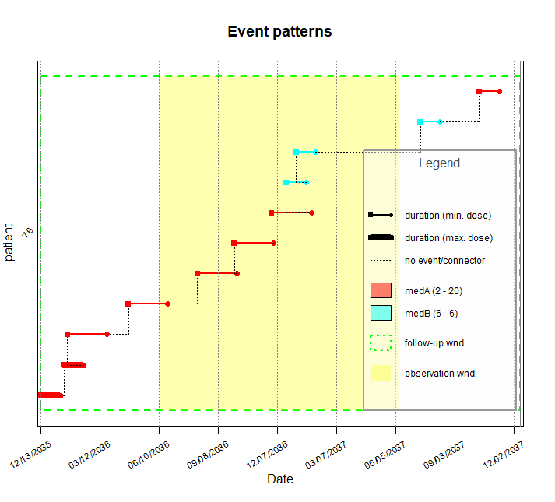
AdhereR Input
PATIENT_ID | DATE | PERDAY | CATEGORY | DURATION
76 | 12/13/2035 | 20 | medA | 30
76 | 01/18/2036 | 20 | medA | 30
76 | 01/23/2036 | 2 | medA | 60
76 | 04/25/2036 | 2 | medA | 60
76 | 08/08/2036 | 2 | medA | 60
76 | 10/03/2036 | 2 | medA | 60
76 | 11/29/2036 | 2 | medA | 60
76 | 12/21/2036 | 6 | medB | 30
76 | 01/05/2037 | 6 | medB | 30
76 | 07/13/2037 | 6 | medB | 30
76 | 10/11/2037 | 2 | medA | 30
Notes:
- requires a prepared dataset of medication events over a follow-up time window of sufficient length in relation to the usual duration of supply and total treatment duration
- minimum dataset: patient ID, event date, duration of supply
Input is a table with Ids, dates, dosage, type of med and duration → the most basic visualisation is CMA0 plot – constructs the segments of med availability on the time line

Slide 43



Data manipulation in R
filter()
arrange()
select()
mutate()
summarise()
DT[i, j, by, ...]
+ group_by()
https://atrebas.github.io/post/2019-03-03-datatable-dplyr/#data.table-and-dplyr

Slide 44
Multiple variables in a column
ID | Med
1 | MedA 50 mg
DT[, c(‘MedName’,
‘Dose’,
‘Unit’) := tstrsplit(Med,
‘ ‘,
fixed=TRUE)]
ID | Med | MedName | Dose | Unit
1 | MedA 50 mg | MedA | 50 | mg

Slide 45
Multiple observations in one row
ID | Med | Disp_Date_1 | Disp_Date_2 | Disp_Date_3
1 | MedA | 2050-01-01 | 2050-01-31 | 2050-03-02
melt(df,
id.vars = c(‘ID’, ‘Med’),
value.name = ‘Disp_Date’)
ID | Med | Disp_Date
1 | MedA | 2050-01-01
1 | MedA | 2050-01-31
1 | MedA | 2050-03-02

Slide 46
One observation in multiple rows
Med | Variable | Value
MedA | Dose | 50
MedA | Unit | mg
MedA | Form | Tbl
MedA | PackSize | 30
dcast(df,
Med ~ Variable)
Med | Dose | Unit | Form | PackSize
MedA | 50 | mg | Tbl | 30

Slide 47
Convert data type
data.table:
dt[, Date := as.Date(Date, format = ‘%d.%m.%Y’]
data.frame:
df$Date <- as.Date(df$Date, format = ‘%d.%m.%Y’)

Slide 48
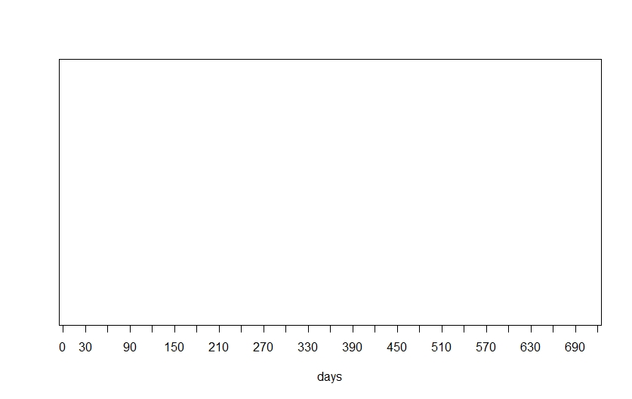
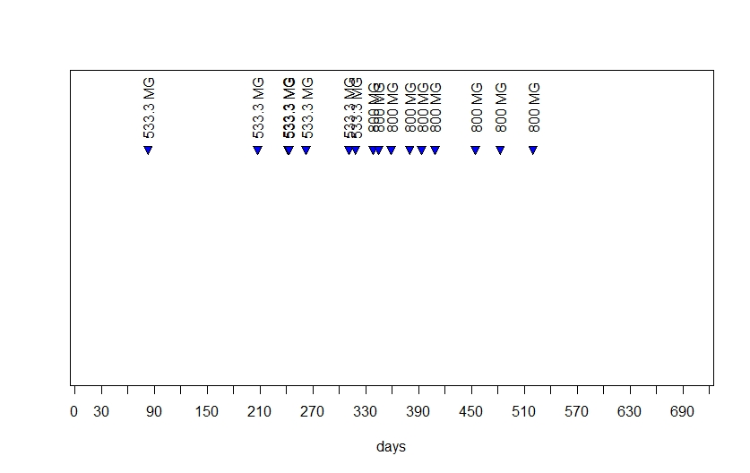
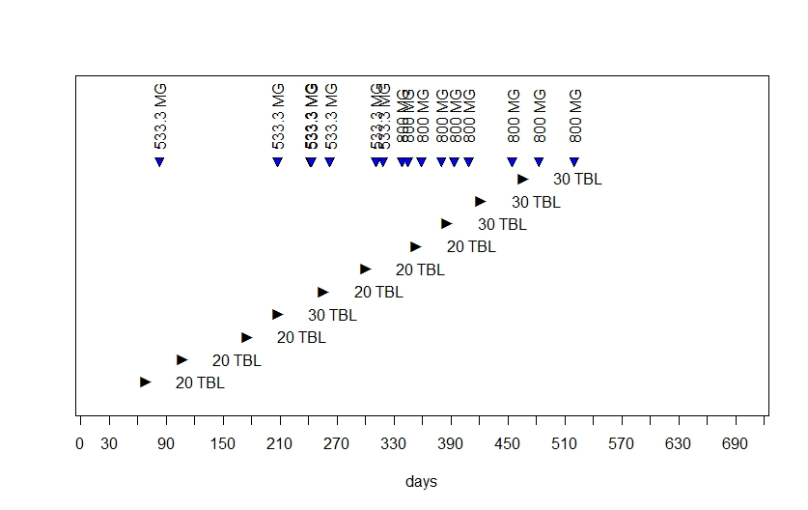
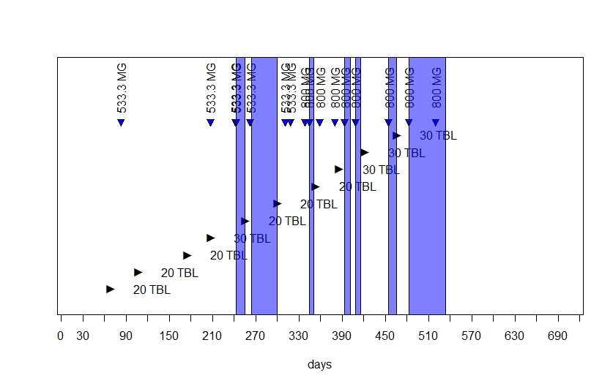
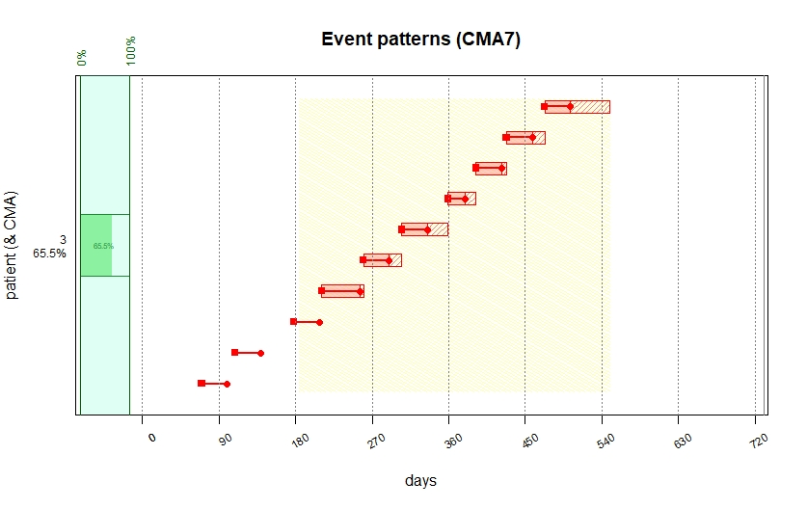
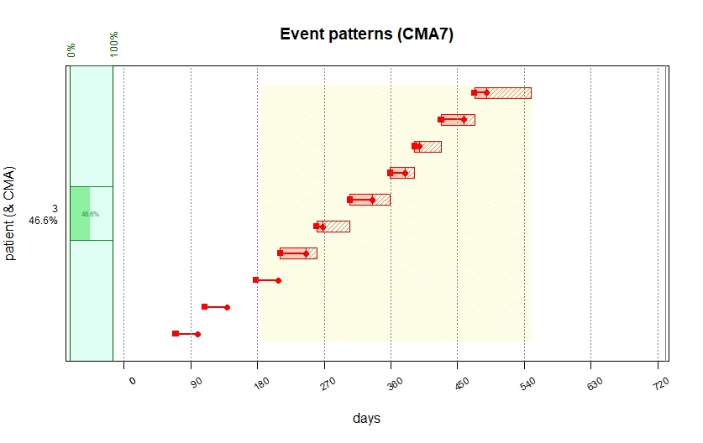
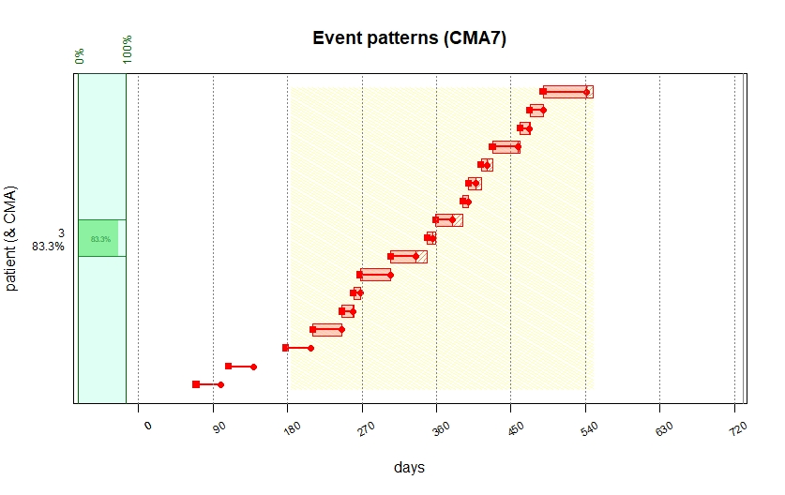
Step 3: Combine multiple sources

Slide 49
Example: Patients with Cystic Fibrosis
25.4%
Hospitalizations
51.1%
Treatment Interruptions
52.8%
Dosage Changes
Allemann S. 11th PCNE Working Conference in Egmond aan Zee (Netherlands), 6-9 Feb 2019.
Rouzé H. Patient Preference and Adherence. 2019;2019(13):1497—1510.

Slide 50
Combine multiple data sources
AdhereR functions to:
automatically select the last prescribed dose to calculate supply duration,
check for prescription changes, hospitalizations, and other treatment interruptions during this period,
adjust the supply duration based on prescription changes and hospitalizations
Samuel S. Allemann, Dan Dediu, Alexandra L Dima. Data preparation for computing adherence to medication in AdhereR. 2019 [cited 2019 September 09]. Available from: https://ddediu.github.io/AdhereR/compute_event_durations/compute_event_durations.html

Slide 51
compute_event_durations
compute_event_durations(disp.data = durcomp.dispensing,
presc.data = durcomp.prescribing,
special.periods.data = NULL,
ID.colname = "ID",
medication.class.colnames = c("ATC.CODE","UNIT","FORM"),
disp.date.colname = "DATE.DISP",
total.dose.colname = "TOTAL.DOSE",
presc.date.colname = "DATE.PRESC",
presc.daily.dose.colname = "DAILY.DOSE",
presc.duration.colname = "PRESC.DURATION",
visit.colname = "VISIT",
split.on.dosage.change = TRUE,
force.init.presc = TRUE,
force.presc.renew = FALSE,
trt.interruption = “continue",
special.periods.method = “continue",
date.format = "%Y-%m-%d",
suppress.warnings = FALSE,
return.data.table = TRUE,
progress.bar = FALSE)
datasets
labels
settings

Slide 52

CALIBER health records research toolkit
To complete
http://caliberanalysis.r-forge.r-project.org/

Slide 53

Thank you!
www.adherer.eu
Notes:
Thank you ESPACOMP, PCNE, EuroDURG, ESCP

